Slide 1
Lecture Eleven Casting Quality
There are numerous opportunities for things to go wrong in a casting operation, resulting in quality defects in the product
The defects can be classified as follows:
General defects common to all casting processes
Defects related to sand casting process

Slide 2
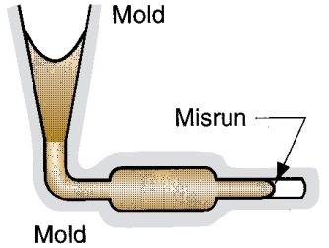
General Defects:
Misrun
A casting that has solidified before completely filling mold cavity

Slide 3
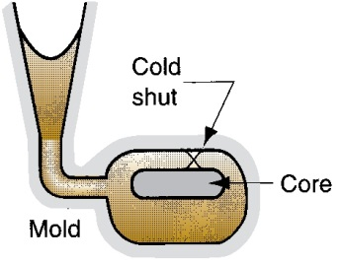
General Defects:
Cold Shut
Two portions of metal flow together but there is a lack of fusion due to premature freezing

Slide 4
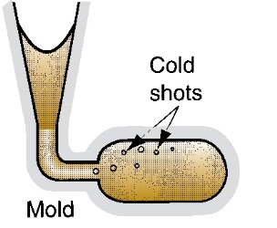
General Defects:
Cold Shot
Metal splatters during pouring and solid globules form and become entrapped in casting

Slide 5
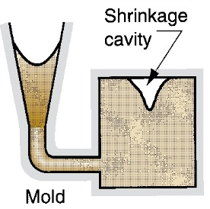
General Defects:
Shrinkage Cavity
Depression in surface or internal void caused by solidification shrinkage that restricts amount of molten metal available in last region to freeze

Slide 6
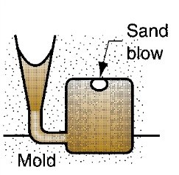
Sand Casting Defects:
Sand Blow
Balloon‑shaped gas cavity caused by release of mold gases during pouring

Slide 7
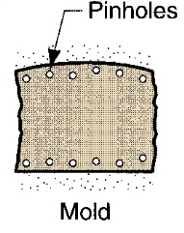
Sand Casting Defects:
Pin Holes
Formation of many small gas cavities at or slightly below surface of casting

Slide 8
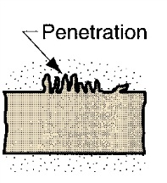
Sand Casting Defects:
Penetration
When fluidity of liquid metal is high, it may penetrate into sand mold or core, causing casting surface to consist of a mixture of sand grains and metal

Slide 9
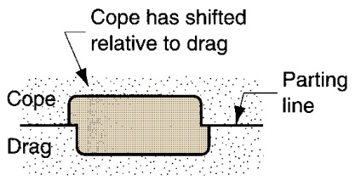
Sand Casting Defects:
Mold Shift
A step in the cast product at parting line caused by sidewise relative displacement of cope and drag

Slide 10
Foundry Inspection Methods
Visual inspection to detect obvious defects such as misruns, cold shuts, and severe surface flaws
Dimensional measurements to insure that tolerances have been met
Metallurgical, chemical, physical, and other tests concerned with quality of cast metal

